Slide 1
Java Applets

Slide 2
Road Map
Introduction to Java Applets
Review applets that ship with JDK
Make our own simple applets
  Introduce inheritance
  Introduce the applet environment
html needed for applets
Reading: The applet coverage in the book is different from the coverage for today. The best review for this material is this PowerPoint presentation.

Slide 3
Applet Viewer and browsers
An applet is a program that suns inside an applet viewer.
The applet viewer takes care of providing the environment and calling several of the applet’s methods.
Modern browsers come with applet capabilities.
The JDK also comes with an applet viewer.
  The JDK applet viewer is really just a minimum browser. It only understands the applet tag.

Slide 4
3.3 Simple Java Applet: Drawing a String
Now, create applets of our own
  Take a while before we can write applets like in the demos
  Cover many of same techniques
Upcoming program
  Create an applet to display
  "Welcome to Java!!"
  Show applet and HTML file, then discuss them line by line

Slide 5
import java.awt.*;
import java.applet.*;
public class WelcomeApplet extends Applet {
public void init() {
}
public void paint(Graphics g) {
g.drawString("Welcome to Java Programming!", 25, 25 );
}
}
extends allows us to inherit the capabilities of class Applet.
Method paint is guaranteed to be called in all applets. Its first line must be defined as above.

Slide 6
3.3 Simple Java Applet: Drawing a String
  Import predefined classes grouped into packages
    When you create applets, import Applet class (in the package java.applet)
    import the Graphics class (package java.awt) to draw graphics
      Can draw lines, rectangles ovals, strings of characters
    import specifies directory structure
import java.awt.*; // import package with class Graphics
import javax.applet.*; // import class Applet

Slide 7
3.3 Simple Java Applet: Drawing a String
  Applets have at least one class declaration (like applications)
    Rarely create classes from scratch
      Use pieces of existing classes
      Inheritance - create new classes from old ones (this will be the next major topic)
  Begins class declaration for class WelcomeApplet
    Keyword class then class name
  extends followed by class name
    Indicates class to extend (Applet)
      Applet : superclass (base class)
      WelcomeApplet : subclass (derived class)
    WelcomeApplet now has methods and data of Applet
public class WelcomeApplet extends Applet {

Slide 8
3.3 Simple Java Applet: Drawing a String
  Class Applet defined for us
    Someone else defined "what it means to be an applet"
      Applets require over 200 methods!
    extends Applet
      Inherit methods, do not have to declare them all
    Do not need to know every detail of class Applet
public class WelcomeApplet extends Applet {

Slide 9
3.3 Simple Java Applet: Drawing a String
  Class WelcomeApplet is a blueprint
    appletviewer or browser creates an object of class WelcomeApplet
      Keyword public required
      File can only have one public class
      public class name must be file name
public class WelcomeApplet extends Applet {

Slide 10
3.3 Simple Java Applet: Drawing a String
  Our class inherits method paint from Applet
    By default, paint has empty body
    Override (redefine) paint in our class
  Methods init, start and paint.
    Guaranteed to be called automatically
    Our applet gets "free" version of these by inheriting from Applet
      Free versions have empty body (do nothing)
      Every applet does not need all three methods
        Override the ones you need
  Applet container “draws itself” by calling method paint
public void paint( Graphics g )

Slide 11
3.3 Simple Java Applet: Drawing a String
  Method paint
    Draws graphics on screen
    void indicates paint returns nothing when finishes task
    Parenthesis define parameter list - where methods receive data to perform tasks
      Normally, data passed by programmer, as in JOptionPane.showMessageDialog
    paint gets parameters automatically
      Graphics object used by paint
    Mimic paint's first line
public void paint( Graphics g )

Slide 12
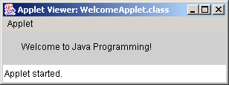
3.3 Simple Java Applet: Drawing a String
  Body of paint
    Method drawString (of class Graphics)
    Called using Graphics object g and dot (.)
    Method name, then parenthesis with arguments
      First argument: String to draw
      Second: x coordinate (in pixels) location
      Third: y coordinate (in pixels) location
  Java coordinate system
    Measured in pixels (picture elements)
    Upper left is (0,0)
g.drawString( "Welcome to Java Programming!", 25, 25 );

Slide 13
3.3 Simple Java Applet: Drawing a String
Running the applet
  Compile
    As you would a regular file in JCreator
      or
    javac WelcomeApplet.java (from the command line)
    If no errors, bytecodes stored in WelcomeApplet.class
  Create an HTML file
    Loads the applet into appletviewer or a browser
    Ends in .htm or .html
  To execute an applet
    Create an HTML file indicating which applet the browser (or appletviewer) should load and execute

Slide 14
3.3 Simple Java Applet: Drawing a String
  Simple HTML file (WelcomeApplet.html)
    Usually in same directory as .class file
    Remember, .class file created after compilation
  HTML codes (tags)
    Usually come in pairs
    Begin with < and end with >
  Lines 1 and 4 - begin and end the HTML tags
  Line 2 - begins <applet> tag
    Specifies code to use for applet
    Specifies width and height of display area in pixels
  Line 3 - ends <applet> tag
<html>
<applet code = "WelcomeApplet.class" width = "300" height = "45">
</applet>
</html>

Slide 15
3.3 Simple Java Applet: Drawing a String
  appletviewer only understands <applet> tags
    Ignores everything else
    Minimal browser
  Executing the applet
    appletviewer WelcomeApplet.html
    Perform in directory containing .class file
<html>
<applet code = "WelcomeApplet.class" width = "300" height = "45">
</applet>
</html>

Slide 16
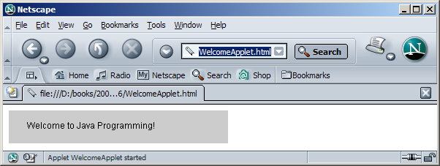
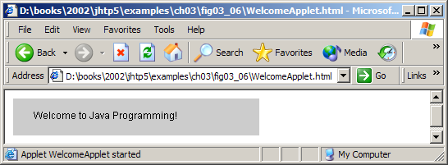
3.3 Simple Java Applet: Drawing a String
Running the applet in a Web browser

Slide 17
3.4 Drawing Strings and Lines
More applets
  First example
    Display two lines of text
    Use drawString to simulate a new line with two drawString statements
  Second example
    Method g.drawLine(x1, y1, x2, y2 )
      Draws a line from (x1, y1) to (x2, y2)
      Remember that (0, 0) is upper left
    Use drawLine to draw a line beneath and above a string

Slide 18
import java.awt.*;
import java.applet.*;
public class WelcomeApplet2 extends Applet {
public void init() {
}
public void paint(Graphics g) {
g.drawString( "Welcome to", 25, 25 );
g.drawString( "Java Programming!", 25, 40 ); }
}
The two drawString statements simulate a newline. In fact, the concept of lines of text does not exist when drawing strings.

Slide 19
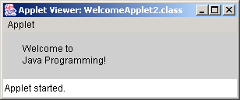
HTML file
Program Output
<html>
<applet code = "WelcomeApplet2.class" width = "300" height = "60">
</applet>
</html>

Slide 20
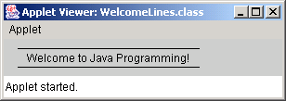
WelcomeLines.java
2. Class WelcomeLines (extends Applet)
3. paint
3.1 drawLine
3.2 drawLine
3.3 drawString
Program Output
import java.awt.*;
import java.applet.*;
public class WelcomeApplet3 extends Applet {
public void init() {
}
public void paint(Graphics g) {
g.drawString("Welcome to Java Programming!", 25, 25 );
g.drawLine (15, 10, 210, 10);
g.drawLine (15, 30, 210, 30);
}
}
Draw horizontal lines with drawLine (endpoints have same y coordinate).

Slide 21
HTML file
<html>
<applet code = "WelcomeApplet3.class" width = "300" height = "40">
</applet>
</html>

Slide 22
3.4 Drawing Strings and Lines
Method drawLine of class Graphics
  Takes as arguments Graphics object and line’s end points
  X and y coordinate of first endpoint
  X and y coordinate of second endpoint

Slide 23
